Slide 1
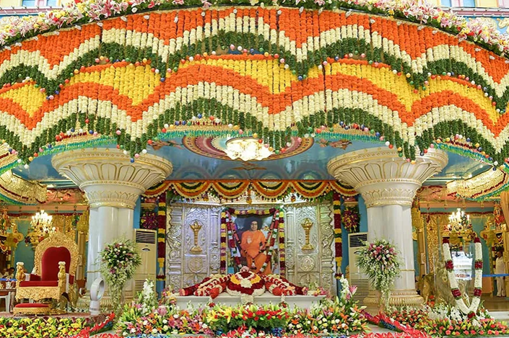
SSSOUK National Pilgrimage 2023 Journey to Sai
Sadhana meeting 5 –3rd June 2023

Slide 2
3 Aums, Vedam and 21 Gayathri Mantra with DarshanVideo of Swami

Slide 3
National President Introduction

Slide 4
Agenda
1 Vedam
2 3 Aums and 21 Gayathri Mantra
3 Swami's discourse
4 Introduction to the day
5 Wing updates
6 Talk by Bro. Ketan Gokani
7 Sarees and Scarves

Slide 5
Agenda
Revisiting a typical day in Prasanthi
Logistics and Website
Q & A
Breakout sessions
Lunch
Breakout sessions continued
Further Q & A if needed
Musical training for the whole group!
Bhajans and Arathi

Slide 6
Offerings in Prasanthi
In Prasanthi, the UK devotees will be offering:
Vedam
Bhajans
Music Programme
Bal Vikas (SSE) Play
Talk about UK Activities
Today we will be having face-to-face practices for devotees who are participating in these offerings. There will be a breakout sessions for vedam, bhajans & musical item, Bal Vikas (SSE) play and Satsang for parents and adults.

Slide 7
Update on the offerings

Slide 8
Spiritual Offerings – Musical & Bhajans
Songs and bhajan practices are underway
The musical offering includes devotional songs in Hindi, Tamil, Telugu, Marathi and English languages
The English song is an improvised bhajan which will transition into Humko Tumse song - aiming to involve all pilgrims to sing a couple of lines. Will try to check it out today
Bhajan pairing and shortlisting of bhajans are in progress – we now have potential additional Bhajan slots
Planning to do a dry run of the musical offering on the 15th July, same day as play dress rehearsal
Final approval will be made by the Prasanthi mandir bhajan group.

Slide 9
Spiritual Offerings - Vedam
Opportunity to chant Vedam on 6 of 7 days.
Main three hymns will be chanted in Prasanthi:
Rudram (Namakam & Chamakam)
Purusha Suktam
Practice sessions - remaining dates are as follows:
Saturday 3rd June (National Pilgrimage meet - Oxhey, R2)
Sat 18th June (Venue TBC)
Sat 1st July (Venue TBC)
Sun 9th July (Venue TBC)
Final decisions on who chants in the lead group will be done by Prasanthi as our programmes will be livestreamed from the Sai Kulwant Hall

Slide 10
Bal Vikas (SSE) Offering
Practices & parent’s commitment
Costumes
Dress rehearsal
Some photos taken during the practices are shown in the next two slides

Slide 11
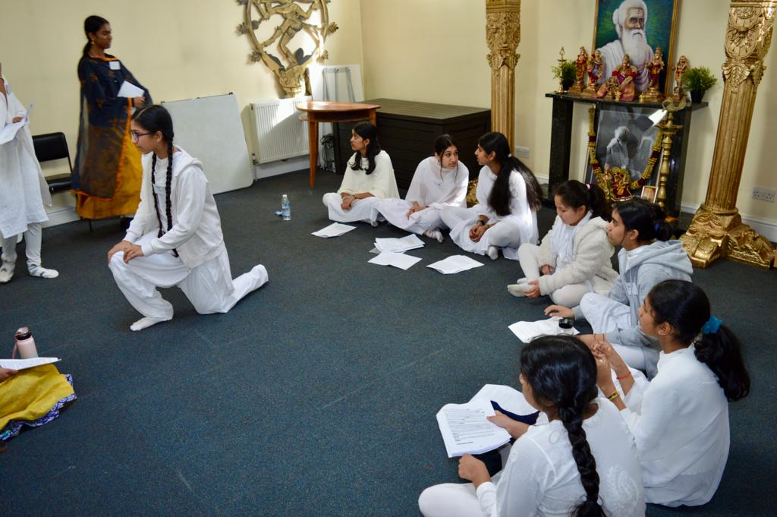
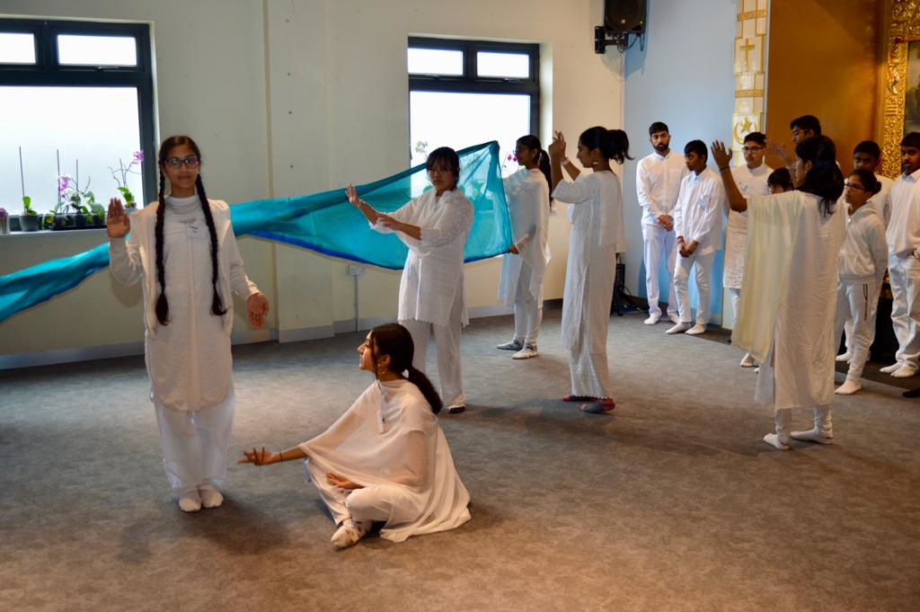
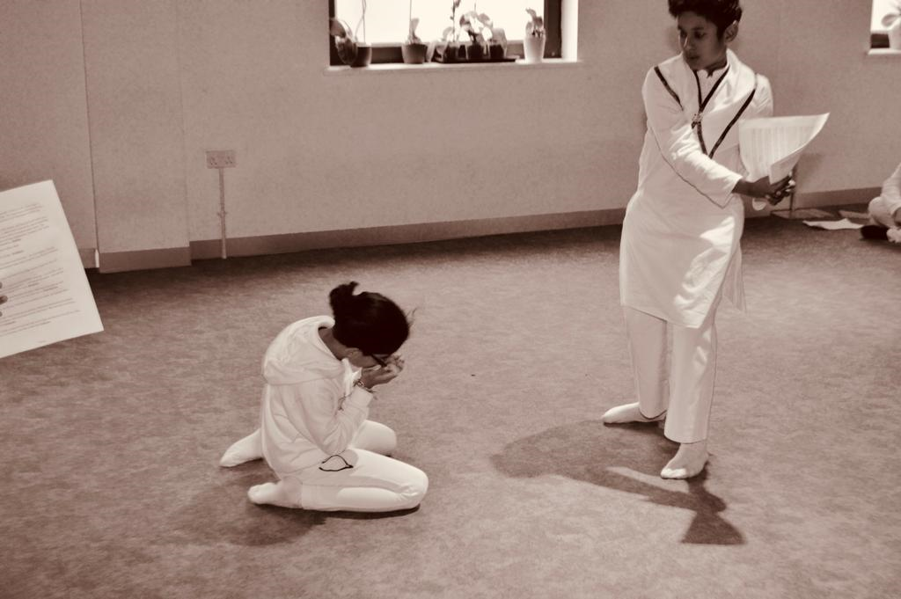
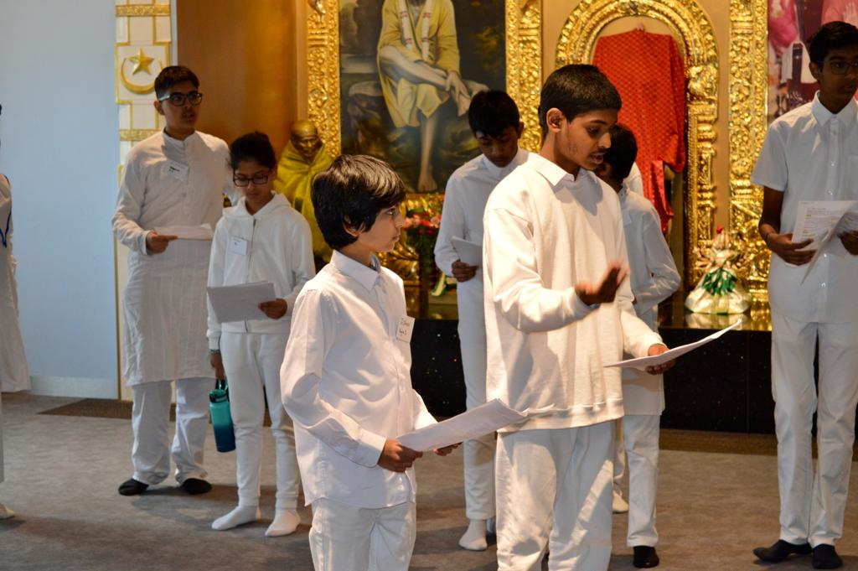
Bal Vikas (SSE) Offering

Slide 12
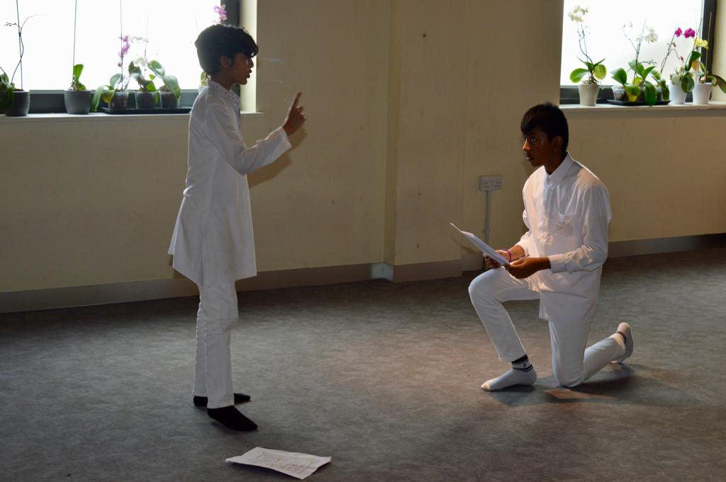
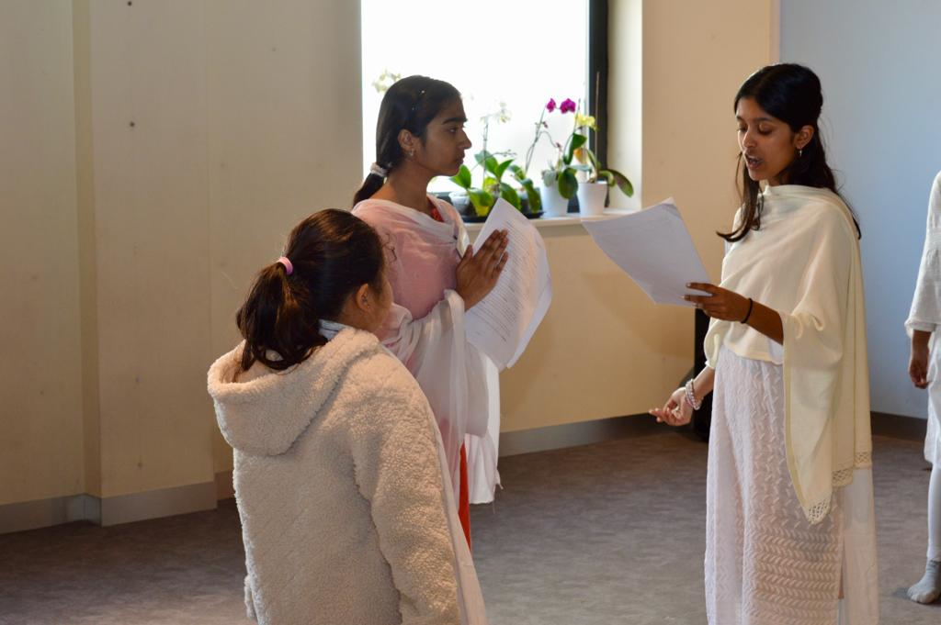
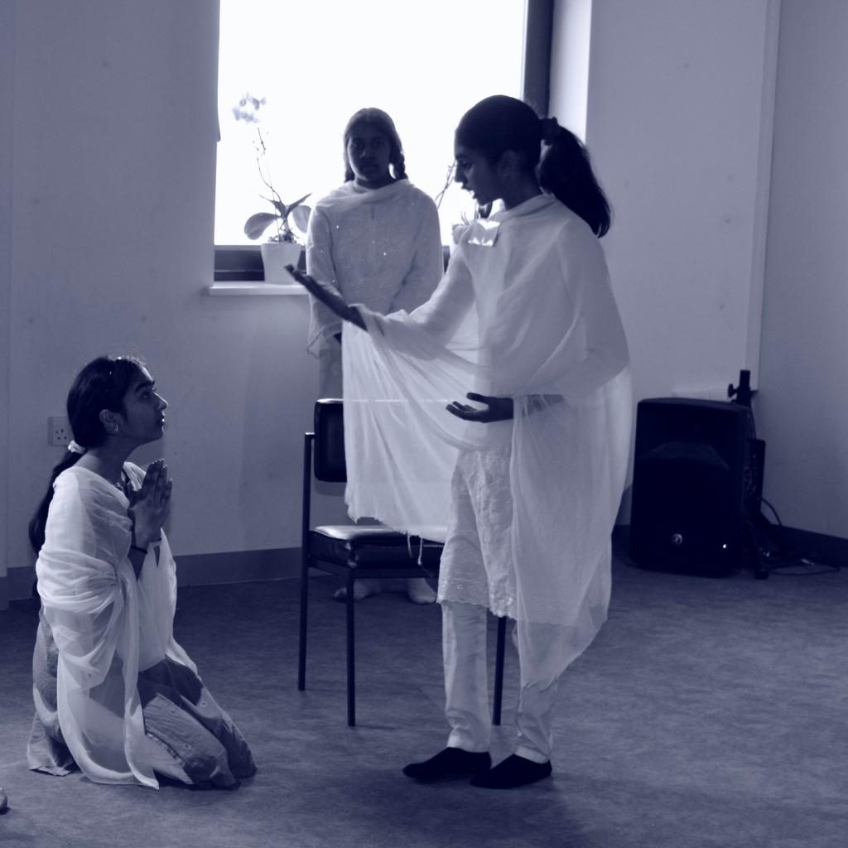
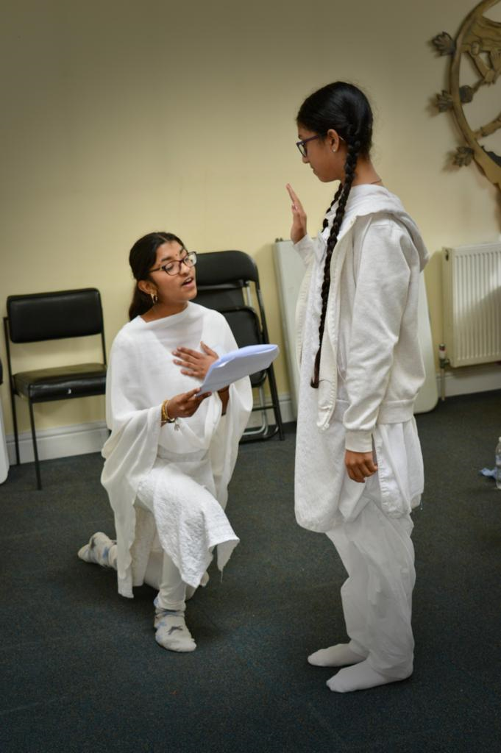
Bal Vikas (SSE) Offering

Slide 13
Service offering for the pilgrimage
We have had many requests regarding what Service we as a group can render while in Prasanthi. This is very encouraging. While we are all excited and enthusiastic, we must also remember that we are as a group bound by certain restrictions and laws whilst we are in India.
Possible Pilgrimage Service Offerings we have considered given our constraints.
1. Seva or help in some way with equipment for a hospital, school, village or orphanage.
2. Prasadam on performance days.
It would be wonderful if we can collectively help in some way and would suggest all to engage in the practice of ceiling on desires as Bhagwan advises
Put into action: 'Ceiling on Desires’.
Practice of the principles of ‘ceiling on desires’, consciously and continuously striving to eliminate the tendency to waste time, money, food, and energy and utilising any savings thereby generated for the service of mankind.”
-Sri Sathya Sai Baba

Slide 14
Service offering for the pilgrimage
Sai Bundles of Joy - Handmade items for new-born babies:
We will be taking Bundles of Joy packs that have already been made. Today, we can pack these as an act of Service.
All can participate in this service by taking a bundle or two with them today and bringing them to Prasanthi to be handed in to our admin office.

Slide 15
Service offering for the pilgrimage
There will also be capacity to get involved in Service activities Individually /groups of people while at the Ashram
These can include.
1. Helping with Admin and manning enquiries office (outside darshan time).
2. The making of props and costumes for the Bal Vikas play,
3. Sevadal Duties (guiding pilgrims on way and during to darshan) and general help

Slide 16
Service offering for the pilgrimage
Everyone can be part of the pilgrimage experience regardless of whether they decide to go to Prashanti in July or not.
This can be in the way of helping wherever help is needed, could be in the form of: research or admin or helping with the Bal Vikas play or the musical offering or just support or help at regional or national sadhana meetings with preparation or setting up the altars or helping in the dining hall. Practicing ceiling on desires so that the savings can be utilised for Seva by during the pilgrimage.
Please discuss this with your centre/group /regional coordinators should you choose to participate in this way while in UK or for any other clarifications regarding our Pilgrimage to Prasanthi.

Slide 17
Taxis
Sai Garuda Travels:
Brother Kishore: +91 94403 23625 (primary no) +91 99496 42355 (Secondary no)
1) Four seater regular car.
Suitable for 3 passengers plus luggage
From Bangalore airport to Puttaparthi drop is Rs. 2500 for one way. With AC.
2) Six seater Innova car.
Suitable for 5 passengers plus luggage
From Bangalore airport to Puttaparthi drop is Rs. 4000 for one way. With AC.
From Puttaparthi to Bangalore airport drop is the same charges for all the above vehicles.
Devotees are kingly requested to contact the company directly and say that they are part of the UK National Pilgrimage

Slide 18
Central Coordinator for UK and Ireland
Talk by Ketan Gokani

Slide 19
Sarees and Scarves

Slide 20
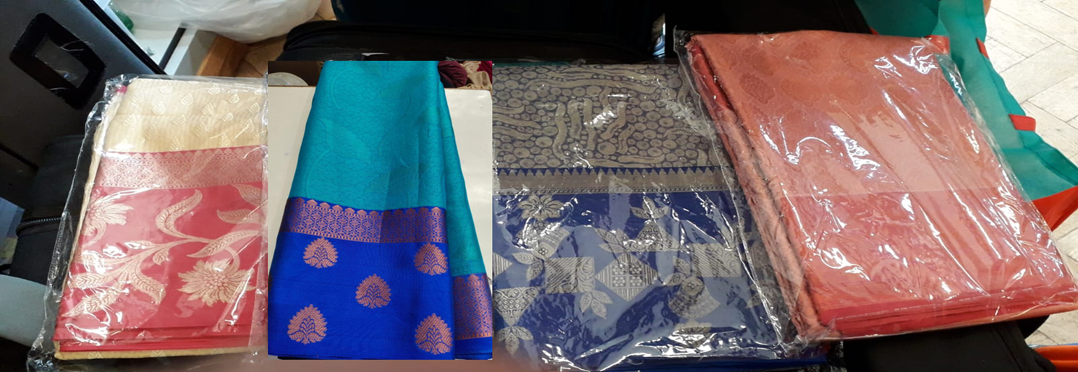
Sarees and Scarves
4 sarees have been chosen by the team of ladies on the UKCC
Sarees will be shipped from Chennai to Parthi
Cost will be £38.00 per person – Blouse pieces will be cut and ends will be stitched
Please make the payment by 17th June to the account mentioned in the email that you would have received
We have ordered sarees for all the Adults and Youth
Samples are here to help with colour matching for blouses

Slide 21
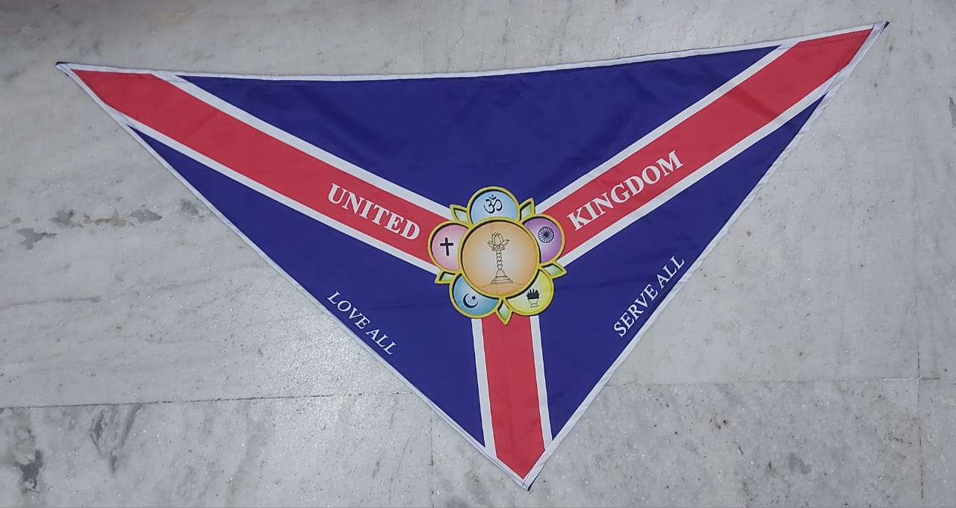
Sarees and Scarves
Scarf designed by one of our Youth – sample received in the UK
The Scarf will be the new UK scarf to be used by service volunteers - not only for the pilgrimage
All devotees on the pilgrimage will be provided with a new scarf to be worn in Prasanthi (cost has been donated by a devotee)

Slide 22
A further look at a typical day in Prasanthi
Roni Ramdin
Region 6 president and Joint National Bal Vikas (SSE) Coordinator

Slide 23
Arrangements and logistics for Pilgrimage

Slide 24
Information needed
Please fill in the google form link below as soon as possible as we need information on your travel plans to the Ashram and information for accommodation:
https://forms.gle/MQfoK2vSnUQXp2Jc8
Currently 43 emails sent and a total of 67 people registered have no accommodation details
226 have submitted accommodation details
Other issues raised in emails:
Some people have submitted accommodation forms where:
- not all people listed are registered
- they have entered names of less people than the stated group size

Slide 25
Important practical information
Information on Passports, Visas, Vaccinations and Baggage allowance can be found on the website – Please apply for visas now (depending on your nationality)
Travel and accommodation information is also available on our National website
We are asking the accommodation office for the latest version of the form that they require to be filled in, so that you can do that before you go to the accommodation office.
Please pay directly in person to the accommodation office on arrival
We will send them a spreadsheet with the details of all those who will be in the group.

Slide 26
Other miscellaneous points
SSSOUK are not responsible for Travel arrangements to Puttaparthi – we have details of the Taxi company and the agreed prices that we have with them as mentioned by Jayeshbhai
Food allergies / dietary requirements:
Devotees will need to ask the canteens personally
Please ensure that you are medically fit to travel
Dress code, all to wear a UK group scarf. Ladies to wear group Sarees
White and white for bal vikas children (churidhar with shawl for girls, shirt and trousers or kurta for boys)
White and white for men (no shorts)
Some more information about things like daily timings in Prasanthi, ashram etiquette, banking etc are available on the website

Slide 27
Dates of the diary - reminder
The pilgrimage starts on Monday 31st July at 7.00am
Please arrive in Prasanthi Nilayam on Saturday 29th or Sunday 30th July
Sadhana Meetings – All meetings are mandatory
Saturday 15th July – Final gathering for prayers as a whole group at Oxhey Wood Primary School (Bal Vikas practices will continue after this date).
Send any questions to: nationalpilgrimage@srisathyasai.org.uk

Slide 28
Sadhana & Website

Slide 29
Sadhana and Website
The following sadhana related materials are now available of the website
Study Circle guide
Vedic chants from Prasanthi (Namakam, Chamakam and Purusha Suktam)
Useful information about Prasanthi Nilayam
The slides from the last Regional Pilgrimage meetings at the end of April
We will be working with regional media coordinators to prepare short videos of devotees’ individual experiences before, during and after the pilgrimage
We will upload a packing list in the next couple of weeks

Slide 30
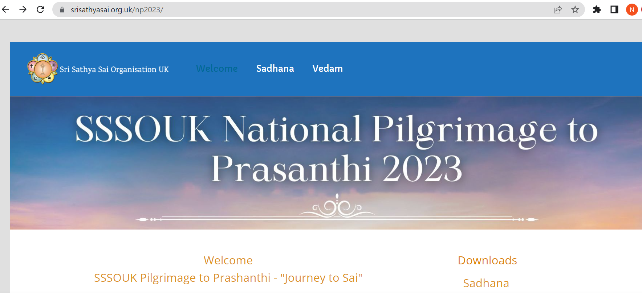
Sadhana and Website

Slide 31
Questions and Answers Session

Slide 32
Breakout Sessions

Slide 33
Lunch

Slide 34
Satsang for Adults continued

Slide 35
Music Session for All Devotees

Slide 36
Female Leads (Deepa, Sharanya, Luckshi, Krisha & Vaishali)
Male Leads (Sathish, Darshan & Akilesh)
Alap by Luckshi and Vaishali
From The Darkness Into Light Lead Me Father
From Unreal To The Real
Baba Sai Baba (x2) (harmonies on repeat - Krisha)
Keyboard Intro (8 beats)
Female Leads (Deepa, Sharanya, Luckshi, Krisha & Vaishali)
Female Leads, Unison Chorus: Every Moment Of My Life Please Be With Me
Female Leads, Unison Chorus: In Every Single Act Of Mine Be Thou My Guide
All: Baba Sai Baba (x2) (harmonies on repeat – Krisha & Vaishali)
Male Leads, Unison Chorus: Neevu Leni Maa Jeevanam
Male Leads, Unison Chorus: Neeru Leni Chepa Vedanam
Male Leads, Unison Chorus: Nee Sannidhe Maaku Pennidhi
Male Leads, Unison Chorus: Needu Chupe Prana Samanam
Male Leads: Neeku Maaku Oke Bandhamu (table ends)
Sathish, Darshan, Akilesh, Sharanya, Luckshi, Vaishali: Adhiye Prema Bandhamu
Tabla Intro

Slide 37
All: Maa O Maa, Maa Sai Maa (x2) (harmonies on repeat – Krisha & Vaishali)
Female Leads, Unison Chorus: When I Slip When I Fall Lend Me your Hand
Female Leads, Unison Chorus: When I Stray Far Away Bring Me Back Again
All: Maa O Maa, Maa Sai Maa (x2) (harmonies on repeat – Krisha & Vaishali)
Group 1 Lead, Group 2 Chorus: Hum Ko Tum Se Pyaar Kitna
Group 1 Lead, Group 2 Chorus: Sai Tum Hi Jantey Hain
Group 1 Lead, Group 2 Chorus: Dilon Ki Dhadkan Tum Ho Sai
Group 1 Lead, Group 2 Chorus: Tum Hamarey Pran Ho
Group 1 Lead, Group 2 Chorus: Hum Ko Tum Se Pyaar Hain
All: We love You dearest Sai, We Love You (x5)
1. All in Unison
2. + Harmonies – Krisha & Vaishali
3. ++ Maa O Maa, Maa Sai Maa – Deepa & Luckshi
4. +++
5. +++
All, Slow: We love You dearest Sai, We Love You

Slide 38
Bhajans and Arathi

