Slide 1
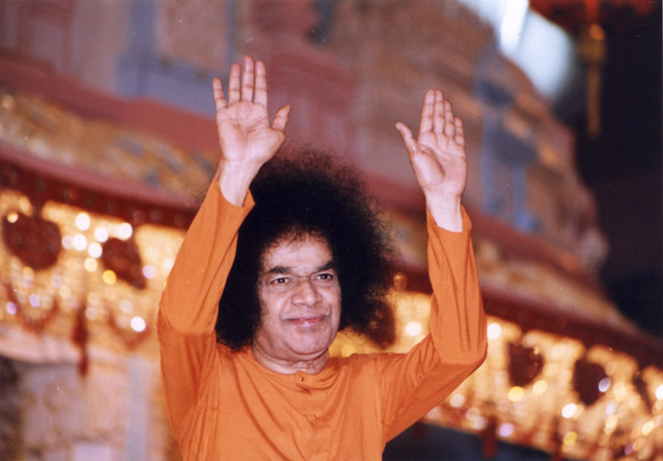
Journey to Sai

Slide 2
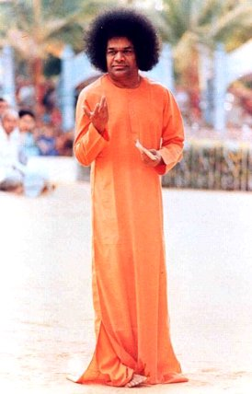
Introduction
Discussions
Take Home Messages
1
2
3

Slide 3
Purpose of the study circle
Understand what having ‘Sai’ as the ‘destination’ really means
01
Delve into the true meaning of ‘Journey to Sai’
02
Learn how to ‘get closer’ to Sri Sathya Sai
03

Slide 4
Discussion 1. What is the destination?

Slide 5
What Sri Sathya Sai says… (1/3)
1
In this context I shall recall what I told the students the other day. "Do not walk in front of Me. I may not follow you. Don't walk behind Me. I may not lead you. Walk beside Me and be My friend." If you attempt to walk in front of Me, you may be taking the wrong path. If you walk behind Me, you may possibly desert Me. Walk abreast of Me. Then there is no chance of your going astray or away from Me, because I am with you. The inner meaning of this is: "You and I are one." Divinity is omnipresent. The Divinity is the Indweller in every being. That being the case, there is no need for you to go in front or walk behind. Take the Divine with you, wherever you go. This is the true mark of the Sadhaka.
Some may say, "We shall worship Swami wherever we may be." Do they have the spiritual competence to make such a claim? If they are true to their claim, they will have no desires of any kind. Till they have reached that state of desireless devotion, they have to follow some kinds of spiritual discipline. Even Rama and Krishna went through a period of discipline under gurus and tried to earn their benediction. Hence they proclaimed the importance of the Guru-Sishya relationship.
- Sri Sathya Sai Speaks, Vol 19, Prasanthi Nilayam, 11 October 1986

Slide 6
What Sri Sathya Sai says… (2/3)
2
Ask For Me You have come, most of you, to get from Me tinsel and trash, petty little cures and promotions, joys and comforts. Very few of you desire to get from Me the thing I have come to give, viz. liberation itself- and even among these few, those who stick to the path of spiritual practice and succeed are a handful. … It is very difficult to demarcate clearly the manifestation of the Lord, so I am announcing Myself and am Myself describing My mission, the task, the characteristics, the qualities that mark out the Avatar from the rest. Do not hunger for comfort or riches; hunger for bliss (ananda). If you have faith, and if you keep the name of Rama as constant companion, you are in heaven (Vaikunta or Kailas) all the time. These are not distant regions that have to be reached by tortuous travel; they are springs of tranquility that are in your own heart. You cannot have this chance of the nearness of the greatest of all sources of joy in any other place. Here, it is so near, so easy to attain, so full of grace. If you fall back, you will seldom get the chance again. Ask and get what will save you, not what will bind you. You ask from Me a thousand things of the world, but rarely do you ask for "Me". That is why I seldom address you as devotees. I usually address you as Embodiments of the Divine (Divyatma swarupulara), for Divinity (Divyathwam) is your real true nature. Though you do not know it, it is a fact, so I can address you so with confidence. I can even call you Embodiments of heavenly Divinity, but as for devotion, since it is a quality that will make you desire the Lord and nothing else, I find you cannot lay claim to it.
– Sri Sathya Sai Speaks, Vol 3, Prasanthi Nilayam, 04 February 1963

Slide 7
What Sri Sathya Sai says… (3/3)
3
To all of you I say, "Let mountains fall, let the sea overwhelm the land, but do not give up your spiritual practices. And remember, spiritual practices are a waste unless you grow at the same time in virtue and uprightness." If you give up all and surrender to the Lord, He will guard you and guide you. When you complain, "Oh! He has not guarded me," I reply, "You have not surrendered." The Lord has come just for this very task. …. Your minds are wayward like monkeys that skip and jump from bough to branch. Give them to Me; I can make them steady and harmless. When I say sit, they will sit; when I say stand, they stand. That is what Sankaracharya offered to do; he told Siva that he would hand over to Him the monkey that was his mind so that it might be tamed and used for His delight. But it must be a complete handing over, with no reservations.
– Sri Sathya Sai Speaks, Vol 3, Prasanthi Nilayam, 04 February 1963

Slide 8
Discussion 2 Where do we begin?

Slide 9
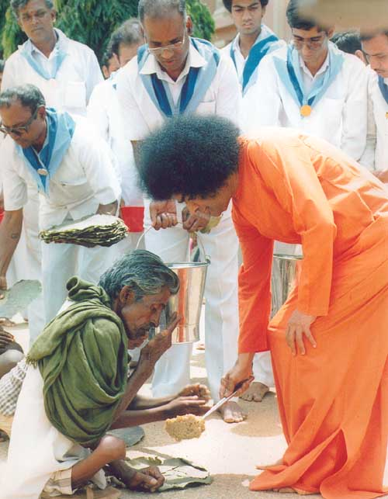
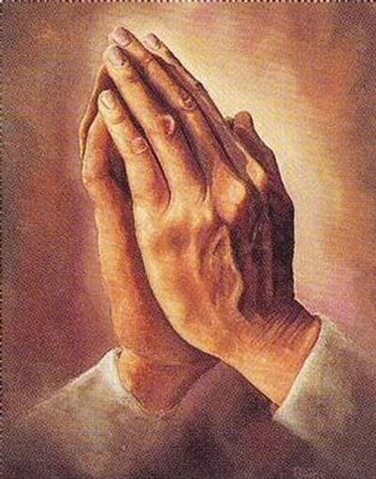
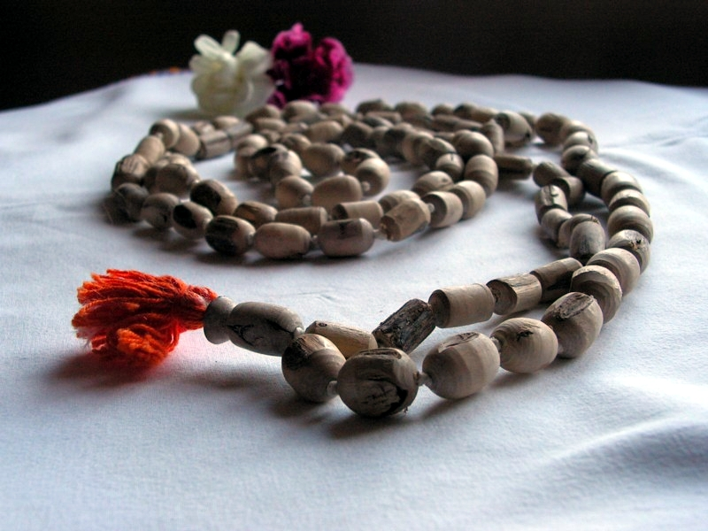
Self realisation
So Ham
Meditation

Slide 10
What Sri Sathya Sai says…
4
Purity is to be preserved and promoted not by multiple baths or by avoiding contact with others condemned as 'untouchables.' You cannot be pure by the observance of the superficial taboo, 'Don't touch.' The body can be clean if washed with water; speech can be cleansed if it is saturated in truth; life can be purified if it is sanctified by thapas (religious austerity), and the intellect can be cleared of blemish through jnana (spiritual wisdom).
- Sri Sathya Sai Speaks, Vol. 14, Ch. 41, Nov 21, 1979
Before sitting for meditation, the mind should be freed from bad thoughts and filled with sacred thoughts. This calls for control over all the sense organs. The ears should be trained to listen only to matters relating to the Divine and to eschew evil gossip. The eyes should be told to see God. The mind should be restrained from restlessness by making it concentrate on the breathing process and relating inhalation and exhalation to the repetition of the manthra, "So-Ham," "So Ham" ("I am He"). By this process, the life-breath is controlled.
- Sri Sathya Sai Speaks, Vol.17, Ch. 6, 11 March 1984
5
Notes:
Swami says just take once thing and follow it religiously

Slide 11
What Sri Sathya Sai says…
6
Let the flame of your love be steady, not flickering. There is no greater sadhana than love. That is the spiritual practice you have to adopt. That is the divine practice. Divinity is omnipresent. You have to realise that omnipresent divinity within your own self. It is present in all the three states of consciousness, namely, dream, wakeful and deep sleep state. One has to strive to experience that divinity constantly. That is Pragnanam Brahma (constant integrated awareness is Brahman). That is sakshatkara (vision of divinity), an experience which transcends all the three states of consciousness.
– Sathya Sai Speaks, Vol 37, Ch 19, 25 October 2004
Notes:
Swami says just take once thing and follow it religiously

Slide 12
Discussion 3. How do we get closer to Sai? What does it mean to get closer?

Slide 13
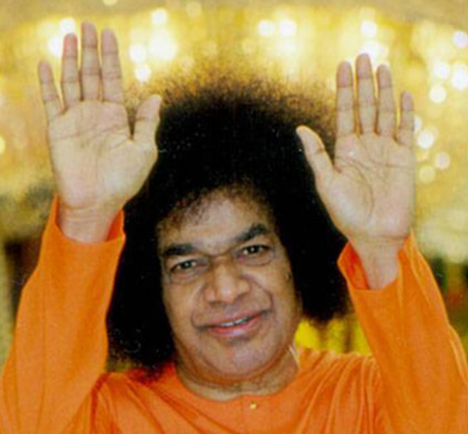
The Journey to Sai
only
then
CAN ONE EXPERIENCE THE ONENESS (INHERENT DIVINITY IN ALL)
SAMYAK DRISHTI (CORRECT VISION),
PREMA (LOVE) & DHARMA (RIGHT ACTION)
which
promotes
PURITY OF THOUGHT, WORD AND DEED
leads to
UNITY OF HEAD, HEART AND HANDS
requires

Slide 14
‘Journey to Sai’ litmus test self assessment
FAIL |  | PASS
Anger |  | Peace of mind
Agitation |  | Always happy
Lack of empathy |  | Compassionate
Presence of vices |  | Content
Fear |  | Courageous
…………. |  | ………….
…………. |  | ………….
…………. |  | ………….

Slide 15
What Sri Sathya Sai says…
7
How To Be Near and Dear To God
Of what avail is it to be
A scholar or clever intellectual
If one does not practice even a
Fraction of what one knows ?
Not all the luxuries and pleasures of the world
Will give a man contentment and peace.
Only when he realises the truth of the Spirit
Will he experience true peace and contentment.
…
…
Dear Students! Embodiments of Divine Love! Whatever a man sees in the world rouses fear in him. Detachment alone can free him from fear. Failing to grasp this profound truth, man is allowing his desires to multiply. As long as man is attached to the body, he cannot get over the desire to possess the objects that attract him. A man afflicted with mamatva (the acquisitive impulse) can never get rid of worries. To overcome this attachment and possessiveness, the ancient sages, from Vedic times, pursued their studies. The sages believed that self-control promoted humility and that humility was the true index of right education.
- Sri Sathya Sai Speaks, Vol.25, Ch. 3, Institute Auditorium, Prashanthi Nilayam, 14 Jan 1992

Slide 16
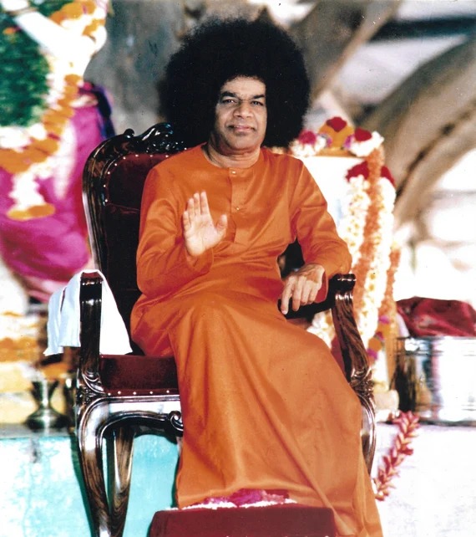
8
No one can liberate you, for no one has bound you. You hold on to the nettle of worldly pleasure, and you weep for pain. The kite is pursued by crows as long as it carries the fish in its beak. It twists and turns in the sky trying to dodge the crows, who seek to snatch the fish. Tired at last, it drops the fish. That moment it is free. So give up attachment to the senses, and grief and worry can harass you no more. The kite sits on a tree, preening its wings, enjoying its happiness. You too can be so happy, provided you drop the fish you have in your beak.
– Sri Sathya Sai Speaks, Vol 3, Prasanthi Nilayam, 04 February 1963

Slide 17
Take home messages

